Slide 1
Fossil fuels
Section 1

Slide 2
Fossil Fuels
A fuel is a substance that provides a form of energy.
Such as heat, light, electricity, or motion.
As a result of a chemical change.

Slide 3
Combustion
The process of burning a fuel is called combustion.
Gasoline + Oxygen Carbon Dioxide + Water

Slide 4
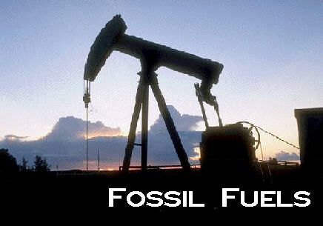
Fossil Fuel

Slide 5
What are Fossil Fuels
Fossil Fuels are the energy rich substances formed from the remains of once-living organisms.
The three major fossil fuels are coal, oil and natural gas.
Fossil fuels are made of hydrocarbons, they contain carbon and hydrogen's.

Slide 6
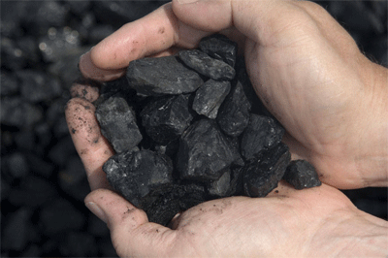
Coal

Slide 7
Coal
Coal is a solid fossil fuel formed from plant remains.
Known deposits of coal (and other fossil fuels) can be obtained using current technology are called reserves.
Coal is the most plentiful fossil fuel in the U.S.
Its easy to transport
It provides lots of energy when burned.

Slide 8
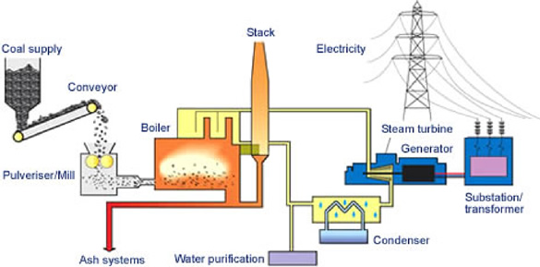
Coal

Slide 9
OIL
Oil is a thick, liquid fossil fuel, it is formed from remains of small animals, algae and protists.
Petroleum is another name for oil.
The United States consumes about one third of all the oil produced in the world.
Only 3% of the world’s supply is located in this country.

Slide 10
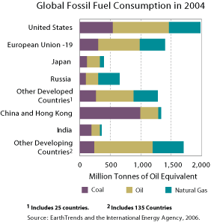
Fossil Fuel Consumption

Slide 11
Refining Oil
When oil is first pumped out of the ground, it is called crude oil.
A factory where crude oil is separated into fuels and other products by heating is called a refinery.

Slide 12
Natural Gas
The third major fossil fuel is natural gas.
It is a mixture of methane and other gases.
Advantages:
Provides lots of energy
Lower levels of air pollutants than coal and oil
Its easy to transport.
Disadvantage:
Highly flammable

Slide 13
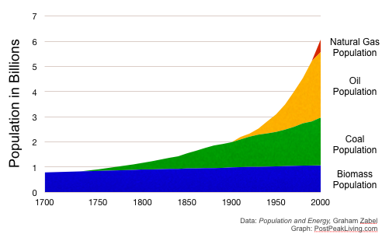
Comparison

Slide 14
Fuel Supply and Demand
Fossil fuel takes hundreds of millions of years to form.
Fossil fuels therefore are considered a nonrenewable resource.
New resources of energy are needed to replace the decreasing fossil fuel reserves.

