Slide 1
TOPIC 2: Industry and Immigration (1865-1914)
Lesson 1: Innovation Boosts Growth

Slide 2
Industry and Immigration (1865-1914)
Lesson 1 Innovation Boosts Growth
Learning Objectives
Analyze the factors that encouraged industrialization in the United States in the late 1800s.
Explain how new inventions, scientific discoveries, and technological innovations fueled growth and improved the standard of living.
Explain the challenges faced by the South in industry and agriculture in the late 1800s.
Describe the impact of industrialization in the late 1800s.

Slide 3
American Industry Grows
1st Industrial Revolution started in Europe in the 1700s
Spread to US; focused on steam power (using coal and iron) and the factory system
Civil War’s effected the US’s need for manufactured products
Weapons, uniforms, medical supplies→ mass produced!
Start of the 2nd Industrial Revolution

Slide 4
American Industry Grows
America was the perfect place for the growth of industry
Access to natural resources to fuel economic development
Coal, timber, oil and rivers (transportation and hydroelectric power)
Growing work force to act as labor- immigration!
Growing entrepreneur class to guide the industrial process (believed in free enterprise)
Aided by Horatio Alger’s stories about “rags to riches”
Laissez-Faire economic policies by the government
Less government involvement in business
Creation of protective tariffs

Slide 5
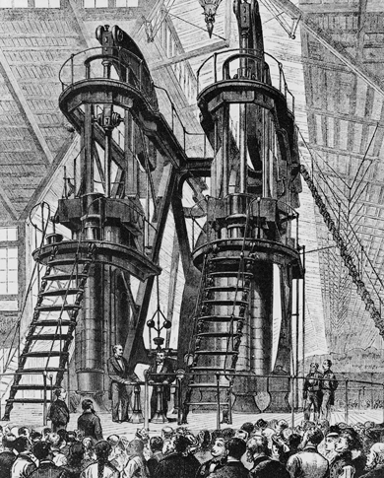
American Industry Grows
President Grant and foreign visitors view the Corliss steam engine, part of the 1876 Centennial Exhibition in Philadelphia that celebrated the 100th anniversary of the United States.

Slide 6
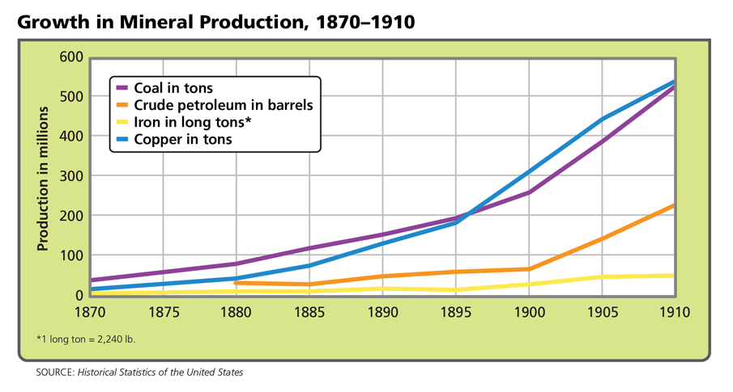
American Industry Grows
Technological innovation prompted the country's production of natural resources to increase significantly. Analyze Graphs What relationship do you see between natural resources and economic growth?

Slide 7
Innovation Drives Economic Development
Entrepreneurship, competition, and the free enterprise system promoted innovation and efficiency in business.
Increase in patents:
federal government gives an inventor the exclusive right to develop, use, and sell an invention for a set period of time
Innovations in electricity
Thomas Edison invented the light bulb; George Westinghouse- central power plants

Slide 8
Innovation Drives Economic Development
Innovations in communication
Samuel Morse 1844; telegraph
Alexander Graham Bell 1876; telephone
Guglielmo Marconi 1896; wireless telegraph→ radio
Innovations in steel
Bessemer Process 1850s
Skyscrapers, suspension bridges, railroads
Transcontinental railroad allowed travel and business to operate on a continental level
1884- time zones
Increased demand for finished products→ mass production using machine

Slide 9
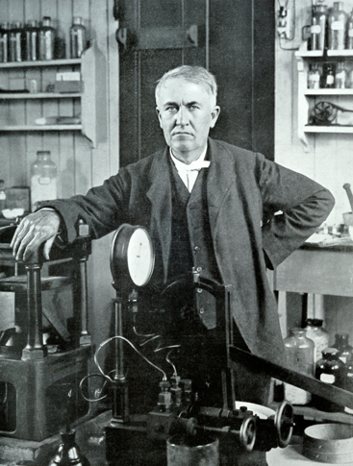
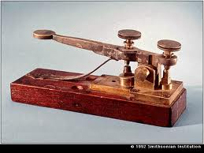
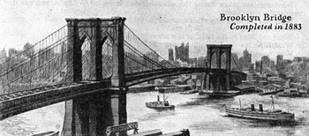
Innovation Drives Economic Development
Thomas Edison, one of history's most prolific inventors, poses with one of his many creations. By the age of 22, Edison had already produced his first major invention, a machine to report stock prices.

Slide 10
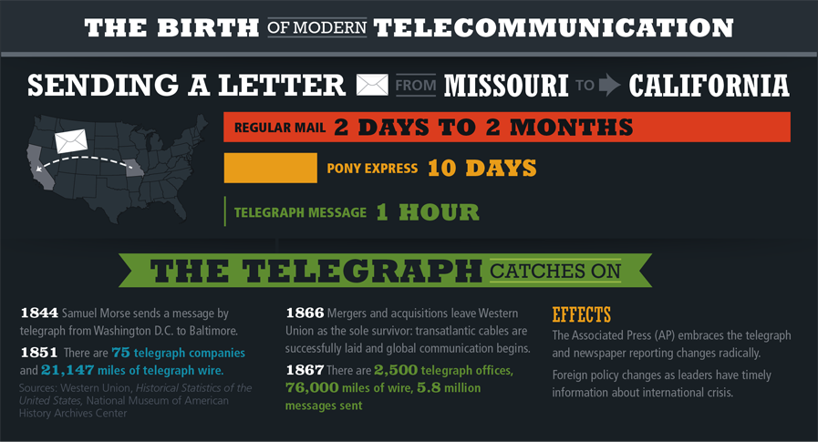
Innovation Drives Economic Development
The telegraph could send a message exponentially faster than standard mail. Infer How did telecommunication innovations improve the standard of living in the United States?

Slide 11
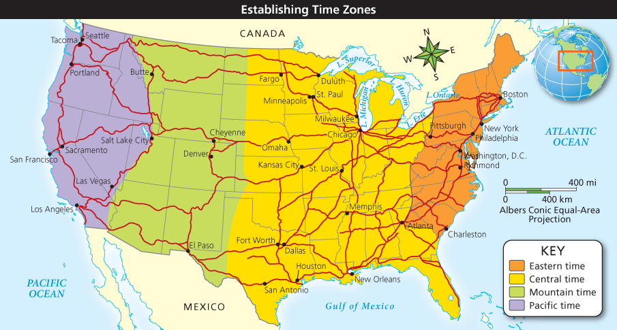
Innovation Drives Economic Development
Railroads expanded across the country in the mid-nineteenth century. Analyze Maps What effect did railroads have on the production and distribution of goods?

Slide 12
Industrialization and the New South
Industry in the North boomed after the Civil War, but lagged behind in the South
South previously focused on agriculture (cash crops- tobacco, cotton etc.)
Atlanta newspaper editor, Henry Grady called for a “New South”
Develop a diversified economy, including industry!
Don’t rely so much on the North!
Somewhat successful- tobacco-processing, stone quarrying, furniture making
Example: Atlanta, Georgia, Knoxville, Tennessee, Birmingham, Alabama etc.

Slide 13
Industrialization and the New South
Needed railroad lines to connect southern industry/agriculture to northern markets→ only 2 by 1880s
South remained mostly agricultural
Lack of investment in education
Low wages= less workers
Lack of banks/capital to invest in industry
Needed to diversify agriculture too→ international competition for cotton and boll weevil destroyed cotton crop in 1890s

Slide 14
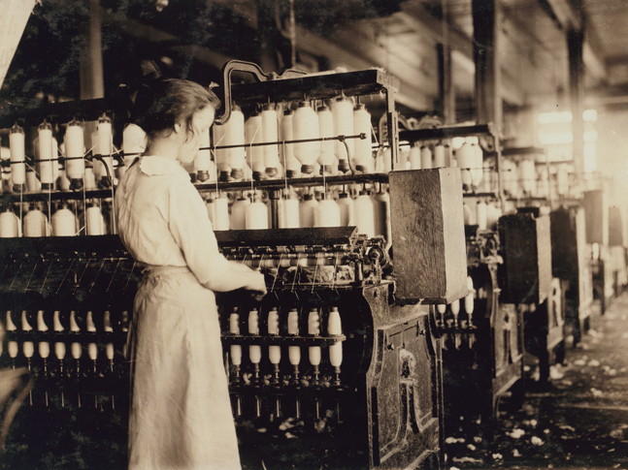
Industrialization and the New South
A worker does her job in a typical Alabama textile mill in the early 1900s. Interpret In what way is this worker a symbol of the 'New South'?

Slide 15
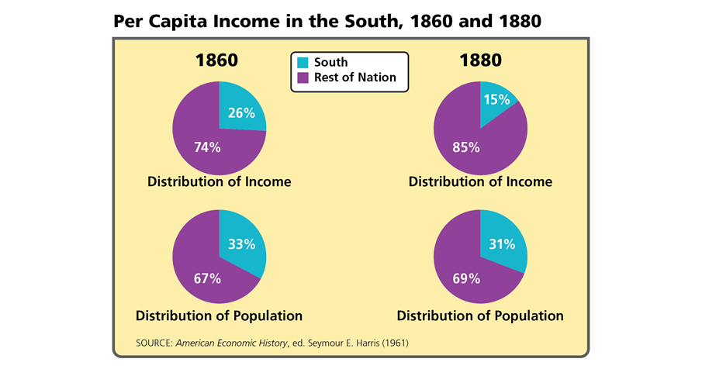
Industrialization and the New South
The South's percentage of income relative to its population fell after the Civil War. Analyze Graphs What does the decline in distribution of income between 1860 and 1880 tell you about the South's economy?

Slide 16
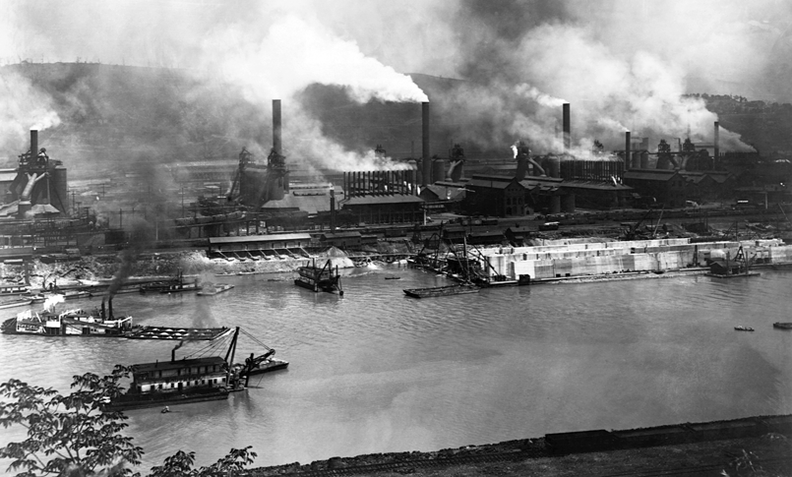

Slide 17
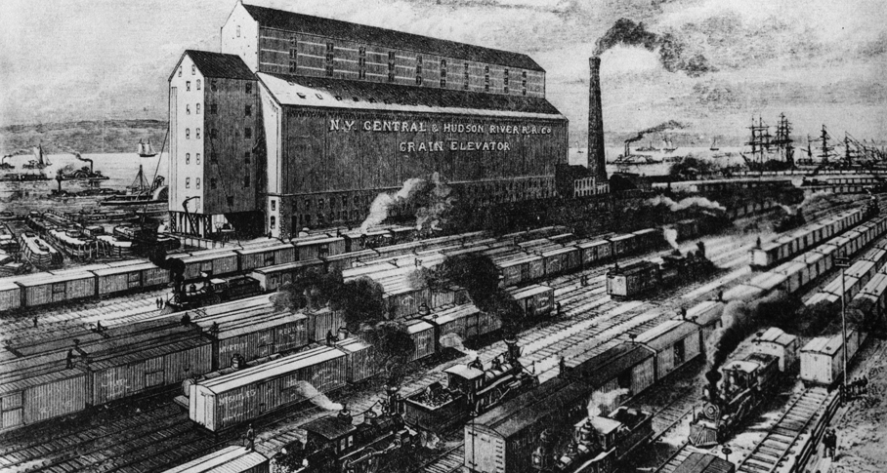
The Effects of Industrialization
From freight yards such as this massive complex in New York City, American industry transported food and other goods nationwide, greatly increasing Americans' access to consumer products.

Slide 18
Quiz: American Industry Grows
During the second Industrial Revolution, immigration was necessary to
A. drive down labor costs.
B. provide needed labor.
C. provide a market for manufactured goods.
D. populate the cities.

Slide 19
Quiz: Innovation Drives Economic Development
The most significant reason railroads encouraged industrial growth was
A. the efficient transportation of raw materials and finished goods.
B. the increase in labor necessary to build railroad cars.
C. the connection of the east and west coasts via railways.
D. the use of the Bessemer process to build steel tracks.

Slide 20
Quiz: Industrialization and the New South
Of the three key elements needed to promote industry, the South lacked
A. all three: natural resources, labor, and investment.
B. two: an educated labor force and capital investment.
C. two: natural resources and an educated labor force.
D. two: natural resources and capital investment.

Slide 21
Quiz: The Effects of Industrialization
In the 1880s, farmers were put out of work by
A. competition with world markets.
B. the development of ways to preserve food.
C. the mechanization of farming methods.
D. poor weather conditions.

